Slide 1
Create a Time Traveling Database
Chris Cumming
Saturday Morning Productions

Slide 2


Who am I? (i.e. Shameless Self Promotion)
Saturday Morning Productions
Consultant/Owner
http://www.saturdaymp.com
chris.cumming@saturdaymp.com
Edmonton .NET Users Group
Program Director
http://edmug.net
info@edmug.net

Slide 3
EDMPASS User Group
http://EDMPASS.PASS.Org
Meetings Every 3rd Thursday 5:30 – 7:30
Canadian Western Bank Conference Centre Lower Concourse (Basement) 10303 Jasper Avenue NW

Slide 4









Thank Our Sponsors

Slide 5
Data Changes Over Time
The only thing that is constant is change.
- Heraclitus

Slide 6


Claim Adjudication
Claims submitted months later.
Customers, Addresses, Relationships,
Companies, Service Providers, Bargaining Agreements,
Coverage Plans, Member Options, Lines of Coverage,
Eligibility, Fee Guides (Dental, Extended Health, etc.),
Fee Codes, Diagnosis Codes, Claim Evidence,
Rule Arguments, Coordination of Benefits

Slide 7
What is a Temporal Database?
Designed for data that changes over time.
Allow past, present, future data and allow gaps.
Use existing database (SQL Server 2005) and tools such as reporting.

Slide 8
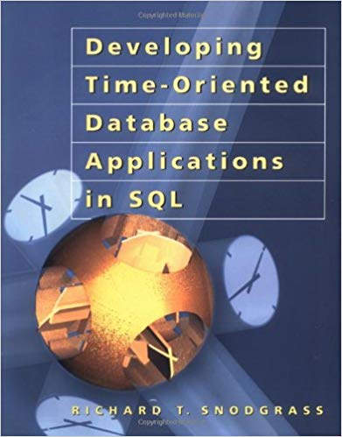
Main Reference
Developing Time-Oriented Database Applications in SQL
Richard T. Snodgrass
PDF Version: https://www2.cs.arizona.edu/people/rts/tdbbook.pdf

Slide 9
Types of Temporalness
Valid (Effective): When the data is true in the real world.
Transaction (Entered): When was the data entered into the database.

Slide 10
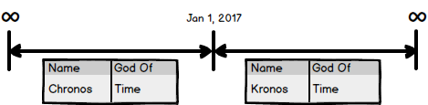
Timelines
Visually represent data changing over time.
Made up of intervals.

Slide 11
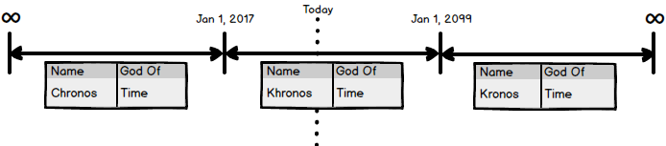
Timeline Properties: Past, Present and Future Intervals

Slide 12
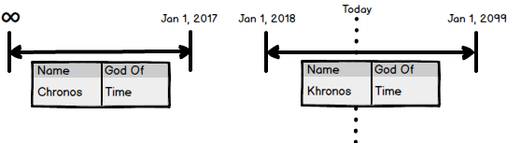
Timeline Properties: Gaps are Allowed

Slide 13
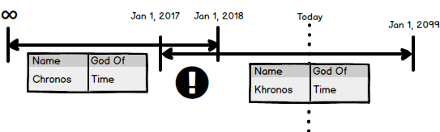
Timeline Properties: Intervals Can’t Overlap!

Slide 14
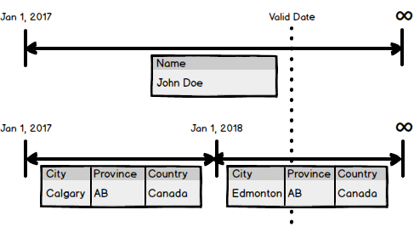
Multiple Timelines

Slide 15

Theory to Practice
Timelines become a record in a table.
Each interval becomes a row in the table.

Slide 16
Creating a Temporal Table
Table has Id, RecordId, StartDate, and EndDate fields.
Id is unique, not null, primary key, and auto incremented.
RecordId is shared across invervals.
CREATE TABLE Customers ( Id INT NOT NULL IDENTITY PRIMARY KEY, RecordId INT NULL, StartDate DATE NOT NULL, EndDate DATE NOT NULL, Name VARCHAR(100), GodOf VARCHAR(100) ) GO

Slide 17
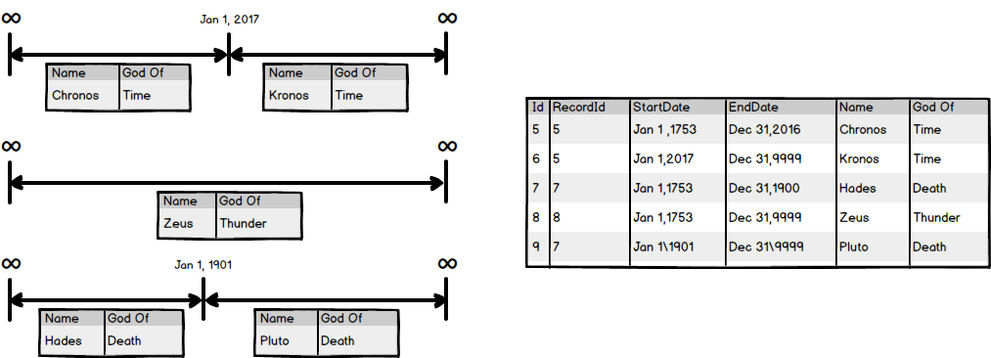
Temporal Table Example

Slide 18
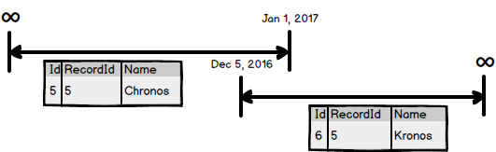
Detecting Overlapping Segments
CREATE TRIGGER TR_<Table>_OverlappingSegments ON <Table> FOR UPDATE, INSERT AS IF EXISTS( SELECT * FROM <Table> t INNER JOIN inserted i On i.RecordId = t.RecordId AND t.Id <> i.Id AND t.StartDate <= i.EndDate AND t.EndDate >= i.StartDate ) BEGIN RAISERROR ('Tried to insert overlapping segments in <Table> table.', 16, 1); ROLLBACK; END GO

Slide 19
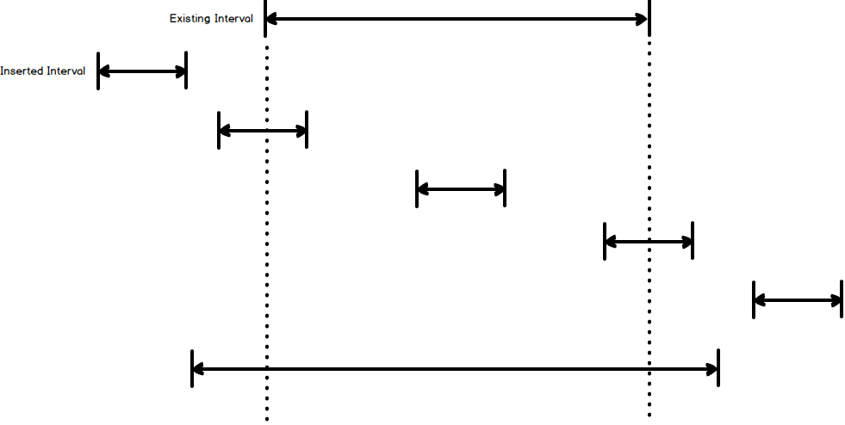
Algorithm to Find Overlapping Segments
Inserted.EndDate >= Existing.StartDate
And Inserted.StartDate <= Existing.EndDate

Slide 20
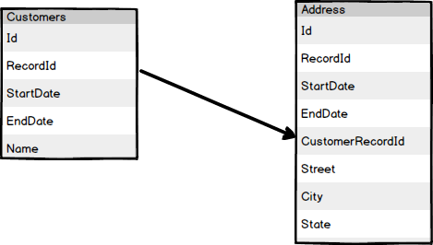
Temporal Foreign Keys
Can’t use SQL Server foreign keys.
Use Triggers instead.
Delete trigger for parent table.
Insert/Update trigger for child table.

Slide 21
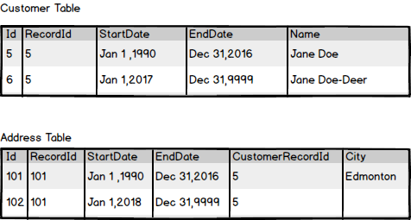
Temporal Foreign Keys Example

Slide 22
Temporal Foreign Key Delete Trigger
CREATE TRIGGER TR_Customers_Addresses_ForeignKey_D ON Customers FOR DELETE AS
IF EXISTS(
SELECT *
FROM Addresses
INNER JOIN deleted ON deleted.RecordId = Addresses.ContactRecId
AND deleted.RecordId NOT IN (
SELECT Customers.RecordId
FROM Customers
WHERE Customers.Id <> deleted.Id
AND Customers.RecordId = deleted.RecordId
)
)
BEGIN
RAISERROR ('Tried to deleted Customers record that is referenced by Addresses forgien key.', 16, 1);
ROLLBACK;
END
GO

Slide 23
Temporal Foreign Key Insert/Update Trigger
CREATE TRIGGER TR_Addresses_Customers_ForeignKey_IU ON Addresses FOR INSERT, UPDATE AS IF NOT EXISTS( SELECT * FROM Customers Where RecordId IN ( SELECT CustomerRecId FROM inserted ) ) BEGIN RAISERROR ('Tried to insert/update Addresses record that had a invalid forgien key to the Customers table.', 16, 1); ROLLBACK; END

Slide 24
Writing Queries
Same as non-temporal queries except:
Filter by valid date:
Select * From Customers Where RecordId = # And StartDate <= ‘2000-03-15’ And EndDate >= ‘2000-03-15’
Join by RecordId:
Select * From Customers c Inner Join Addresses a On a.CustomerRecId = c.RecordId And c.StartDate <= ‘2000-03-15’ And c.EndDate >= ‘2000-03-15’ And a.StartDate <= ‘2000-03-15’ And a.EndDate >= ‘2000-03-15’

Slide 25
Not Covered
Not all data need temporality (i.e. financial tables).
Joining to non-temporal tables.
Fields that shouldn’t change (i.e. birthdate).

Slide 26
Learn More
Slides and Example Code
https://github.com/saturdaymp-examples/create-a-time-travelling-database
Contact Me
chris.cumming@saturdaymp.com
@saturdaymp
Thank you attending my presentation. Questions?

